Slide 1
Project on: EUB-APGT (Automated Payroll and GPS Tracker)
Presented By
Sourav Kundu
Supervised By:
Shraboni Afroz
Farid Hossain
Md Abid Hasan
Id: 180222042
Id: 180222047
Id: 180222048
Sr. Lecturer, Dept. of CSE,
European University of Bangladesh
Thursday 4th November 2021

Slide 2
Outline
Introduction
Related Works
Motivation for The Work
Objective
Approach
How works the system
Date of completion
Conclusion

Slide 3
Introduction
GPS tracking of employee location
Measure remuneration based on work hour
Automated payroll

Slide 4
Related Works
Title: AC Payroll, Ultimatix Payroll etc.
Type: Android Application
Their Work Principle | Our Work Principle
Android application performing employee attendance and salary management system. They did not provide live location tracking. | Our system will provide both employee attendance, hourly salary and live employee location on Map using GPS tracker.

Slide 5
Motivation
Automated payroll.
First well organized online payroll app for our country.
No need to check employee’s physical activities.

Slide 6
Objective
1. Helps organizations prepare daily employee attendance system
2. Monitoring remote working employees in real time
3. Get live employee’s working location through app
4. Calculating daily remuneration for employees according to their work hour
5. Controlling employees by admin (Remove employee, online payment)

Slide 7




Approach
Platform/Framework | Backend | GUI | Database
Native Android with Android Studio | Java | XML | Firebase

Slide 8
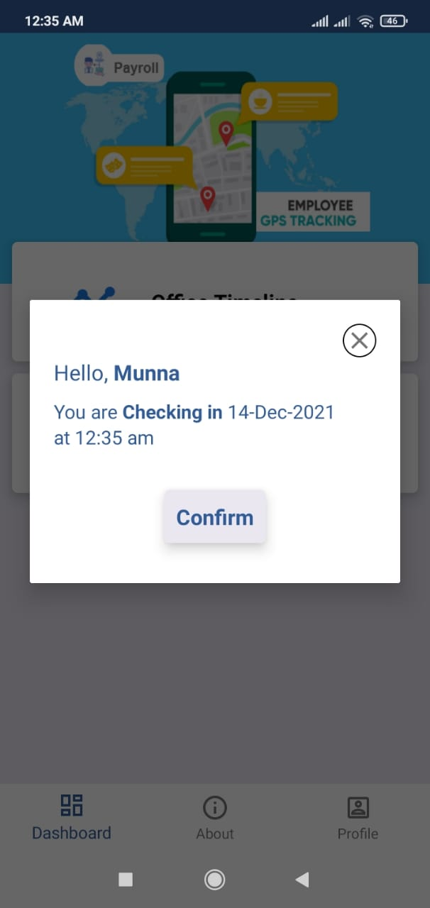
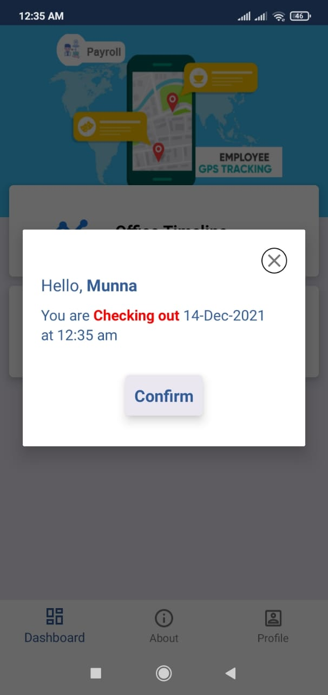
How the proposed system will work (Feature)
Employee Check-in
Employee Check-out

Slide 9
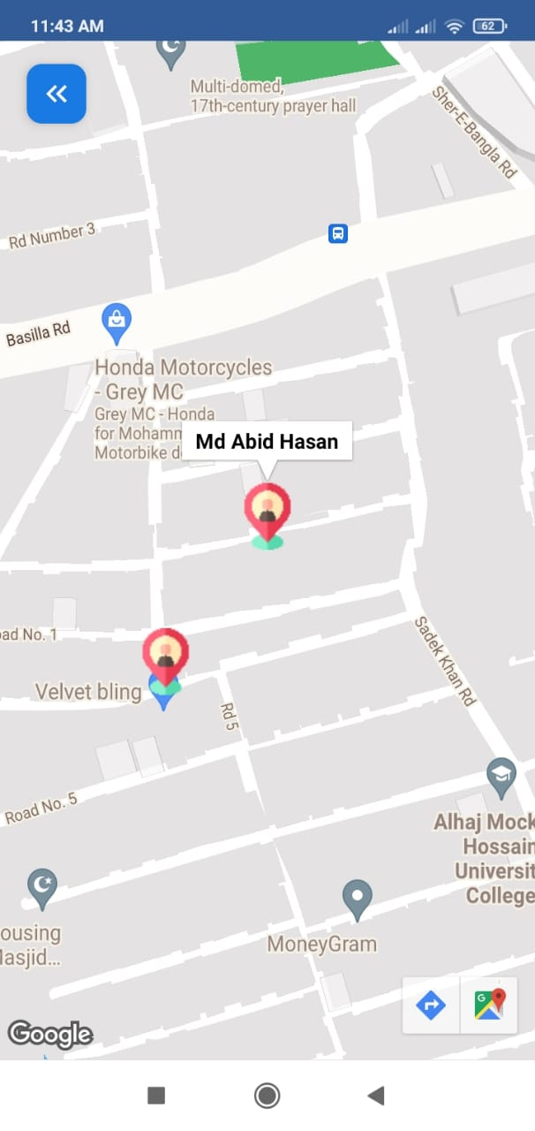
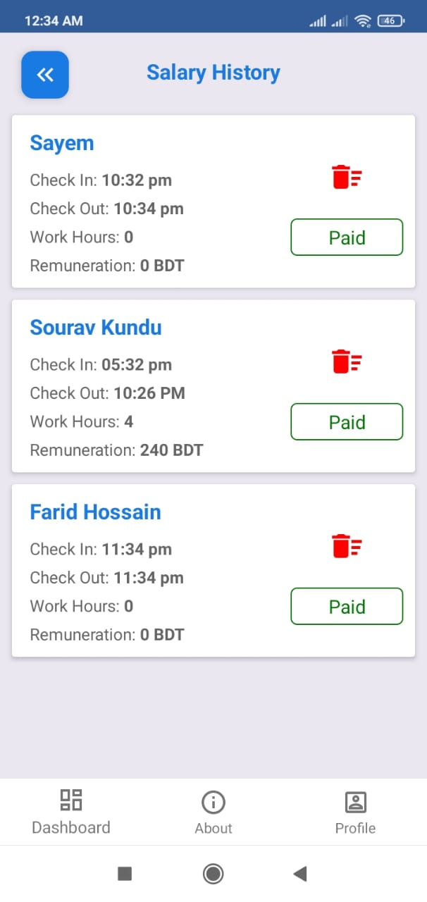
Feature (continue…)
Inspection by Admin using Employee Geo-Location
Automated Payroll by Admin

Slide 10
Date of completion
We will finished up to the detection and evaluation of my proposed work within October 14, 2021.

Slide 11
Conclusion
We are introducing automated payroll using GPS location tracking which uses to view an employee by using the employee’s geographical location and locate the longitude and latitude positions and we can view the path the way he travelled throughout the day and calculates the employee salary, it eradicates the proxy attendances and fake salary calculations.

Slide 12
Thank you

